Slide 1
Lecture 01 – Digital images
SIN 393 – Introduction to Computer Vision (2022-2)
Prof. João Fernando Mari
joaofmari.github.io
joaof.mari@ufv.br

Slide 2
Agenda
The digital image
Colored images – RGB
The RGB color space
Spatial resolution
Intensity resolution

Slide 3

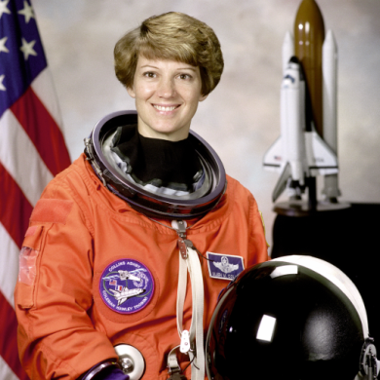
The digital image
Intensity image (gray levels):
Colored image (RGB):

Slide 4

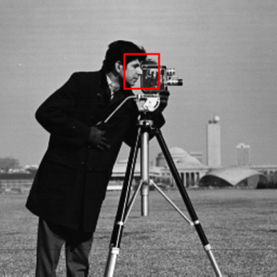
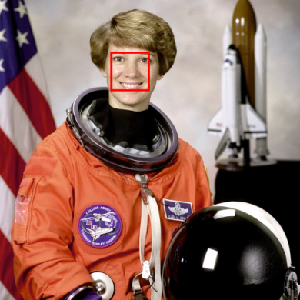

The digital image
Intensity image (gray levels):
Colored image (RGB):

Slide 5
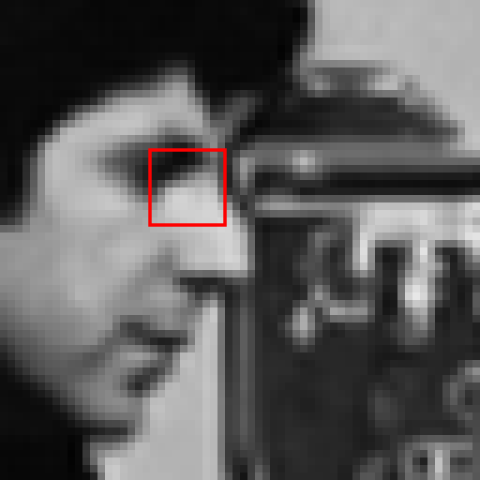

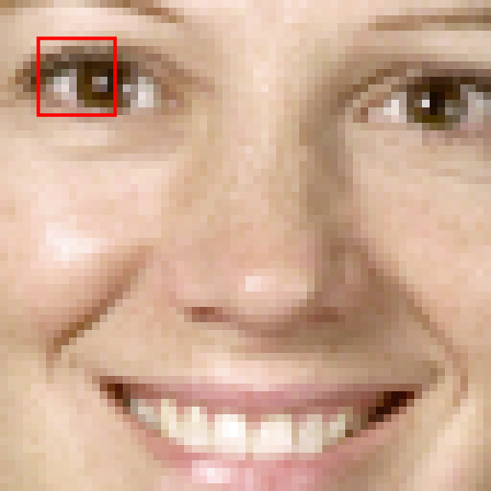

The digital image
Intensity image (gray levels):
Colored image (RGB):

Slide 6
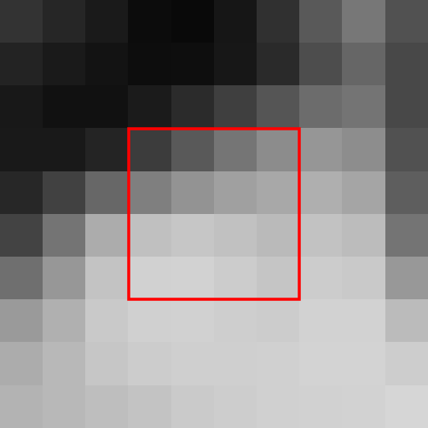

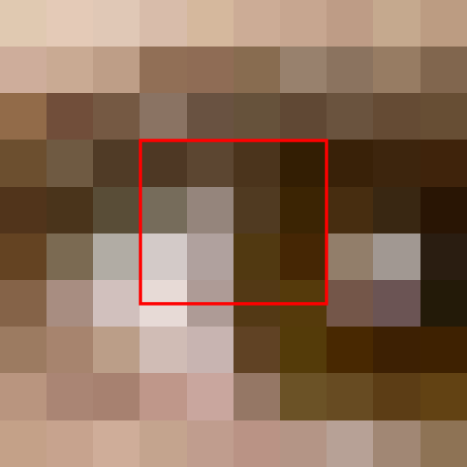

The digital image
Intensity image (gray levels):
Colored image (RGB):

Slide 7
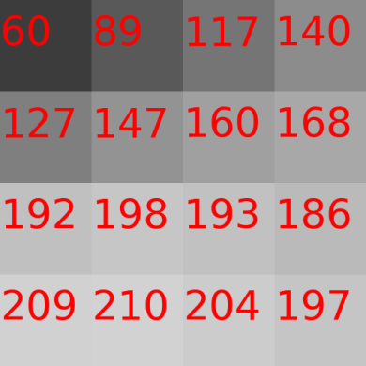
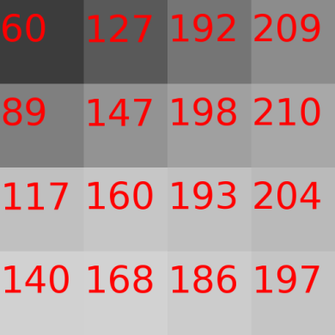
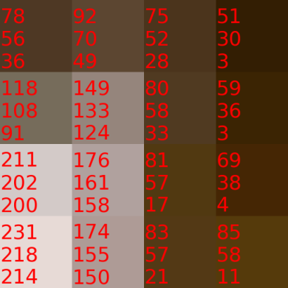
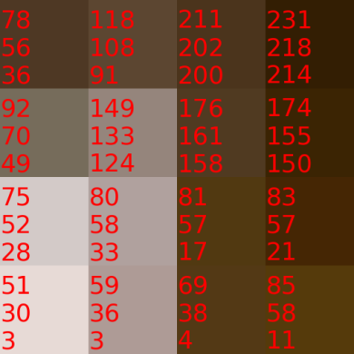
The digital image
Intensity image (gray levels):
Colored image (RGB):

Slide 8

The digital image
 | 0 |  |  |  |  |  |  |  |  |  |  |  |  |  | N-1 |  | y
0
M-1
x

Slide 9
The digital image
origin (0, 0)
column y
 | 0 |  |  |  |  |  |  |  |  |  |  |  |  |  | N-1 |  | y
0
M-1
x
row x
f(x, y) = [R, G, B]
M rows
N columns
M × N pixels

Slide 10
Colored images – RGB

Slide 11
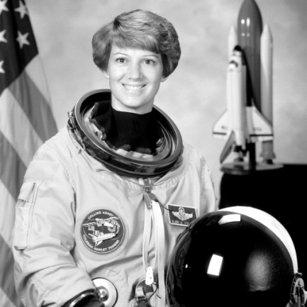
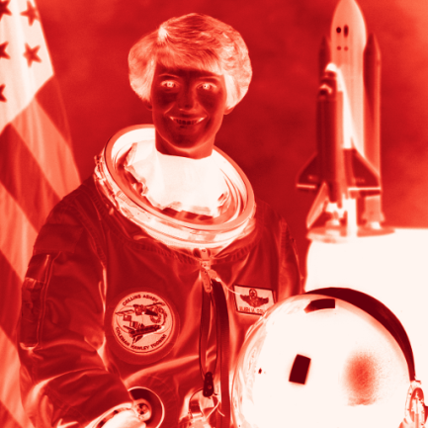
Colored images – RGB
R (red)

Slide 12
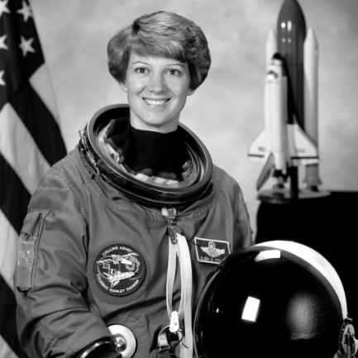
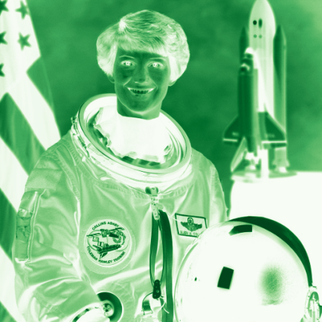
Colored images – RGB
R (red)
G (green)

Slide 13
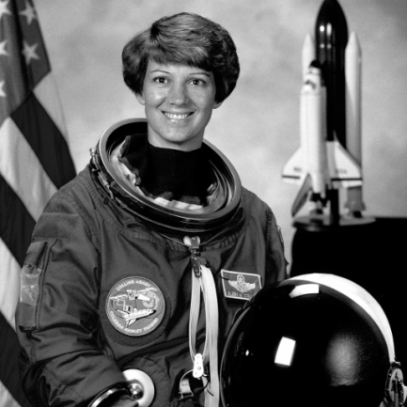
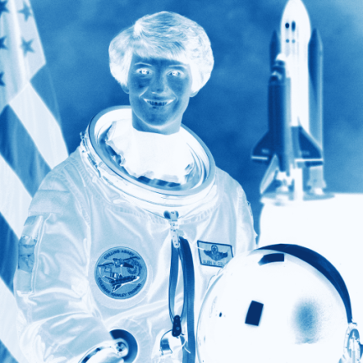
Colored images – RGB
R (red)
G (green)
B (blue)

Slide 14



Colored images – RGB
R (red)
G (green)
B (blue)

Slide 15
The RGB color space
B
Blue (0, 0, 255)
Cyan (0, 255, 255)
255
Magenta (255, 0, 255)
White (255, 255, 255)
Gray (127, 127, 127)
Green(0, 255, 0,)
0
Black (0, 0, 0)
255
G
255
R
Red (255, 0, 0)
Yellow (255, 255, 0)

Slide 16




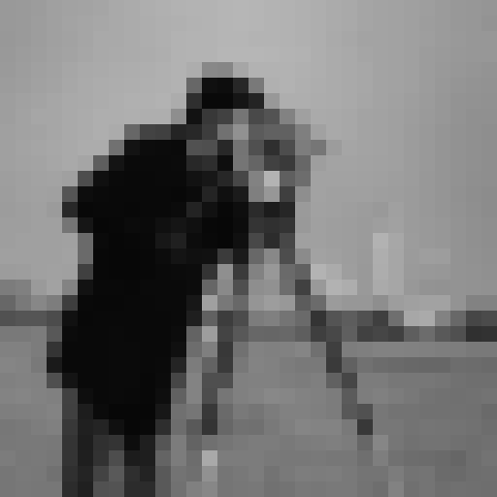
Spatial resolution
1.7 pol
300 ppi – 512 x 512
1.7 pol. at 150 ppi – 256 x 256
1.7 pol. at 75 ppi – 128 x 128
1.7 pol. at ~38 ppi – 64 x 64
1.7 pol. at 19 ppi – 32 x 32

Slide 17





Spatial resolution
0.85 pol.
256 x 256 pixels
300 ppi
1.7 pol.
512 x 512 pixels
300 ppi
0.43 pol.
128 x 128 pixels
300 ppi
0.21 pol.
64 x 64 pixels
300 ppi
0.11 pol.
32 x 32 pixels
300 ppi

Slide 18
Intensity resolution
∞ gray levels
8 bits
256 gray levels
7 bits
128 gray levels
6 bits
64 gray levels
5 bits
32 gray levels
4 bits
16 gray levels
3 bits
8 gray levels
2 bits
4 gray levels
1 bit
2 gray levels

Slide 19
Intensity resolution
∞ gray levels
8 bits
256 gray levels
7 bits
128 gray levels
6 bits
64 gray levels
5 bits
32 gray levels
4 bits
16 gray levels
3 bits
8 gray levels
2 bits
4 gray levels
1 bit
2 gray levels

Slide 20




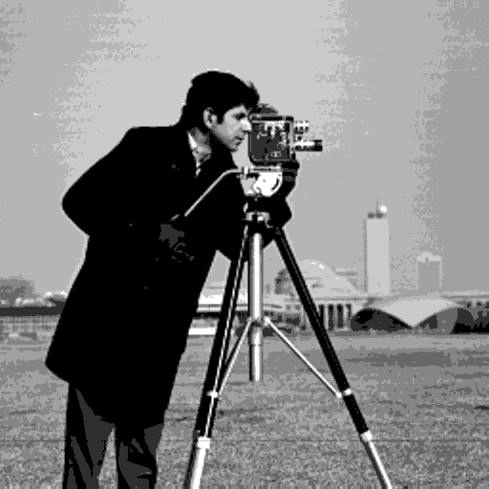
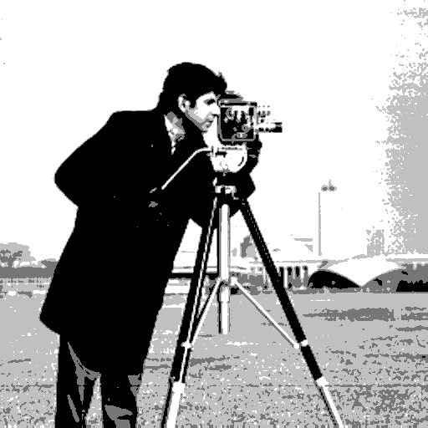
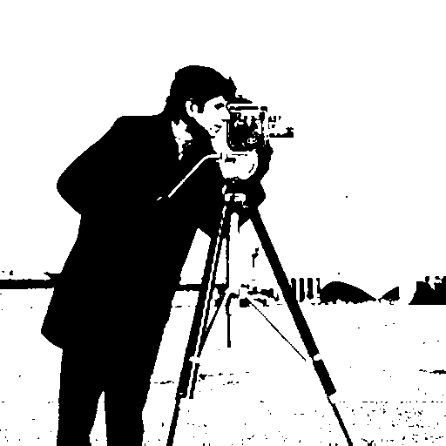
Intensity resolution
8 bits. 2⁸ = 256 gray levels
7 bits. 2⁷ = 128 gray levels
6 bits. 2⁶ = 64 gray levels
5 bits. 2⁵ = 32 gray levels
4 bits. 2⁴ = 16 gray levels
3 bits. 2³ = 8 gray levels
2 bits. 2² = 4 gray levels
1 bit. 2¹ = 2 gray levels

Slide 21
Bibliography
GONZALEZ, R.C.; WOODS, R.E. Digital Image Processing. 3rd ed. Pearson, 2007.
MARQUES FILHO, O.; VIEIRA NETO, H. Processamento digital de imagens. Brasport, 1999.
(in Brazilian Portuguese)
Available on the author's website (for personal use only)
http://dainf.ct.utfpr.edu.br/~hvieir/pub.html
J. E. R. Queiroz, H. M. Gomes. Introdução ao Processamento Digital de Imagens. RITA. v. 13, 2006.
(in Brazilian Portuguese)
http://www.dsc.ufcg.edu.br/~hmg/disciplinas/graduacao/vc-2016.2/Rita-Tutorial-PDI.pdf
PETERS, A. Lectures on Image Processing. Vanderbilt University, 2019.
https://archive.org/details/Lectures_on_Image_Processing

Slide 22
THE END

